Slide 1
Food Security As Resilience: Reconciling Definition and Measurement
J.B. Upton, J.D. Cissé* & C.B. Barrett
Cornell University
Global Food Security Conference 2015 – Ithaca, NY
October 13, 2015
*Presenter, based on ICAE 2015 presentation by Dr. Barrett

Slide 2
“Before there were evaluations of anti-poverty programs, or analysis of inequality trends, or really most of empirical development economics, there had to be something more fundamental: measurement. We had to know how to assess poverty, and we needed to have large-scale data to do so, to challenge our assumptions, and provide new answers.”
- Chris Blattman, FP 10/12/15

Slide 3
Motivation
Food security matters
Measurement matters
Difficult to measure something intrinsically unobservable
Must be based on agreed-upon definition

Slide 4
Definition
“Food security exists when all people at all times have physical, social, and economic access to sufficient, safe and nutritious food that meet their dietary needs and food preferences for an active and healthy life.”
- World Food Summit, 1996

Slide 5
Decades of grappling with measurement
Different metrics have different goals
Reflect 1 or more observable dimensions
Combine dimensions using indices
No existing measure well captures “food insecurity” per internationally agreed definition

Slide 6
“Food security exists when all people at all times have physical, social, and economic access to sufficient, safe and nutritious food that meet their dietary needs and food preferences for an active and healthy life.”

Slide 7
“Food security exists when all people at all times have physical, social, and economic access to sufficient, safe and nutritious food that meet their dietary needs and food preferences for an active and healthy life.”

Slide 8
“Food security exists when all people at all times have physical, social, and economic access to sufficient, safe and nutritious food that meet their dietary needs and food preferences for an active and healthy life.”

Slide 9
FS Measurement Axioms
“all people” – the scale axiom (address both individuals and groups at various scales of aggregation)
“at all times” – the time axiom (assess stability, given both predictable and unpredictable variation)

Slide 10
“Food security exists when all people at all times have physical, social, and economic access to sufficient, safe and nutritious food that meet their dietary needs and food preferences for an active and healthy life.”

Slide 11
“Food security exists when all people at all times have physical, social, and economic access to sufficient, safe and nutritious food that meet their dietary needs and food preferences for an active and healthy life.”

Slide 12
“Food security exists when all people at all times have physical, social, and economic access to sufficient, safe and nutritious food that meet their dietary needs and food preferences for an active and healthy life.”

Slide 13
FS Measurement Axioms
“physical, social, and economic access” – the access axiom (must control for poverty, institutions, infrastructure)
“an active and healthy life” – the outcomes axiom (nutrition/health outcome indicators are the ultimate targets)

Slide 14
Data Challenges
Shortcomings in national-level data
… and also in household data
Consistency over time
Cost
Location
BUT new data sources & tech emerging

Slide 16
Tradeoffs

Slide 17
A Development Resilience Approach?
Barrett & Constas (PNAS 2014)
Probabilistic approach – dynamic well-being measurement
Moments-based

Slide 18
Addressing Axioms
Time axiom (short and long term dynamics
Scale axiom (estimate for individuals/ households but aggregable to larger groups)

Slide 19
Addressing Axioms
Access axiom (conditioning on economic, physical, or social characteristics)
Outcomes axiom (outcomes are either proxy or direct indicators of health/nutrition status)

Slide 20
Example – Northern Kenya
924 households, 5 annual rounds
Data collected by ILRI to assess impacts of Index Based Livestock Insurance
Period encompasses a massive drought (2011)
Data: livestock holdings, expenditures, food consumption, child anthropometry, environmental conditions

Slide 21
Process
Procedure by Cissé & Barrett (in progress)
Normative judgements
Level – Minimum acceptable standard of ‘adequate well-being’ (the outcome) for an individual or household.
Probability – Minimum acceptable likelihood of meeting level

Slide 22
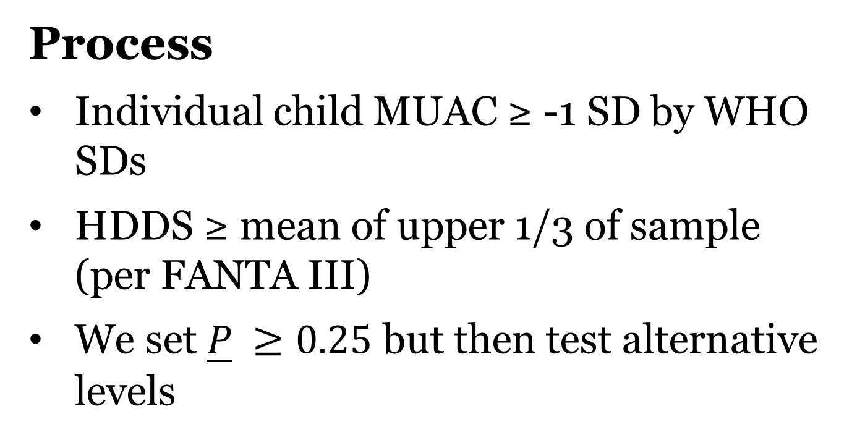
Process
Individual child MUAC ≥ -1 SD by WHO SDs
HDDS ≥ mean of upper 1/3 of sample (per FANTA III)
We set $\underline{P} ≥0.25$ but then test alternative levels

Slide 23
Step 1
Estimate the conditional mean MUAC and HDDS equations, conditioned on:
Lagged well-being (MUAC/HDDS) in cubic polynomial to allow for nonlinear path dynamics
A range of access indicators – wealth (TLUs), location, demographics, etc. OLS w/robust standard errors.

Slide 24
Step 2
Capture residuals and estimate conditional variance similarly.
Assume normality for simplicity in illustration

Slide 25
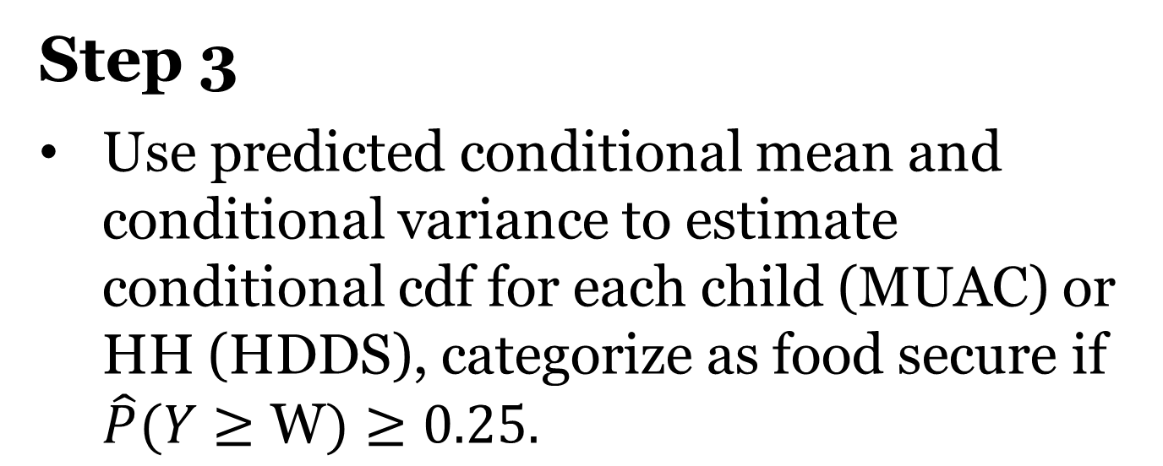
Step 3
Use predicted conditional mean and conditional variance to estimate conditional cdf for each child (MUAC) or HH (HDDS), categorize as food secure if $\hat{P}(Y≥\text{W})≥0.25.$

Slide 26
FGT-type Aggregation

Slide 27
Takeaways & Next Steps
Measurement is important
Must respect the definition
Development Resilience Approach may hold promise wrt meeting axioms
Need to improve data availability (Headey & Barrett PNAS 2015 on sentinel sites)

Slide 28
Thank You!
Email – jdc358@cornell.edu
Twitter – @jenncisse

Slide 29
return
Moments-based
Describe stochastic well-being dynamics (in reduced form) with moment functions:
m^{k}(W_{t+s} | W_{t}, X_{t}, ε_{t})
where m^{k} represents the k^{th} moment (e.g., mean (k=1), variance (k=2), etc.)
W_{t} is well-being at time t
X_{t} is vector of conditioning variables at time t
ε_{t} is an exogenous disturbance (scalar or vector)

